Slide 1
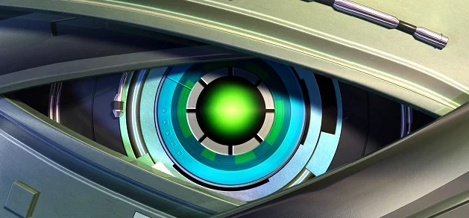
Convolution Neural Network
PhD. Msc. David C. Baldears S.
PhD.(s) Msc. Diego López Bernal
https://cnvrg.io/data-science-platform/dataset-management/

Slide 2
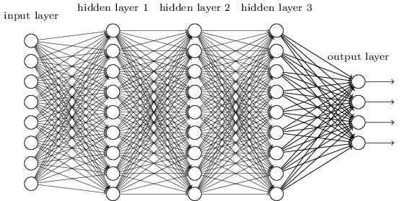
Convolution Neural Network
It is good to learn a small model.
From this fully connected model, do we really need all the edges?
Can some of these be shared?

Slide 3


Consider learning an image:
Some patterns are much smaller than the whole image
Can represent a small region with fewer parameters
“beak” detector

Slide 4

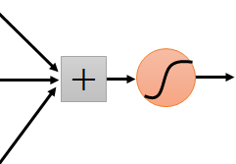
Same pattern appears in different places:
They can be compressed!
What about training a lot of such “small” detectors and each detector must “move around”.
“upper-left beak” detector
They can be compressed
to the same parameters.
“middle beak” detector

Slide 5
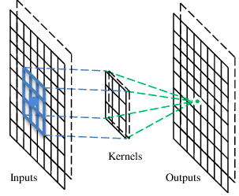
A convolutional layer
A CNN is a neural network with some convolutional layers (and some other layers). A convolutional layer has a number of filters that does convolutional operation.

Slide 6
Convolution
These are the network parameters to be learned.
1 | -1 | -1
-1 | 1 | -1
-1 | -1 | 1
1 | 0 | 0 | 0 | 0 | 1
0 | 1 | 0 | 0 | 1 | 0
0 | 0 | 1 | 1 | 0 | 0
1 | 0 | 0 | 0 | 1 | 0
0 | 1 | 0 | 0 | 1 | 0
0 | 0 | 1 | 0 | 1 | 0
Filter 1
-1 | 1 | -1
-1 | 1 | -1
-1 | 1 | -1
Filter 2
……
6 x 6 image
Each filter detects a small pattern (3 x 3).

Slide 7
Convolution
1 | -1 | -1
-1 | 1 | -1
-1 | -1 | 1
Filter 1
stride=1
Dot
product
1 | 0 | 0 | 0 | 0 | 1
0 | 1 | 0 | 0 | 1 | 0
0 | 0 | 1 | 1 | 0 | 0
1 | 0 | 0 | 0 | 1 | 0
0 | 1 | 0 | 0 | 1 | 0
0 | 0 | 1 | 0 | 1 | 0
3
-1
6 x 6 image

Slide 8
Convolution
1 | -1 | -1
-1 | 1 | -1
-1 | -1 | 1
Filter 1
If stride=2
1 | 0 | 0 | 0 | 0 | 1
0 | 1 | 0 | 0 | 1 | 0
0 | 0 | 1 | 1 | 0 | 0
1 | 0 | 0 | 0 | 1 | 0
0 | 1 | 0 | 0 | 1 | 0
0 | 0 | 1 | 0 | 1 | 0
3
-3
6 x 6 image

Slide 9
Convolution
1 | -1 | -1
-1 | 1 | -1
-1 | -1 | 1
Filter 1
stride=1
1 | 0 | 0 | 0 | 0 | 1
0 | 1 | 0 | 0 | 1 | 0
0 | 0 | 1 | 1 | 0 | 0
1 | 0 | 0 | 0 | 1 | 0
0 | 1 | 0 | 0 | 1 | 0
0 | 0 | 1 | 0 | 1 | 0
3
-1
-3
-1
-3
1
0
-3
-3
-3
0
1
3
-2
-2
-1
6 x 6 image

Slide 10
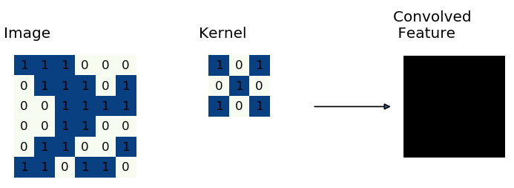
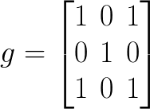
Convolution
Kernel Moving over the image
Notes:
g = \begin{bmatrix}
1 & 0 & 1\\
0 & 1 & 0\\
1 & 0 & 1
\end{bmatrix}

Slide 11
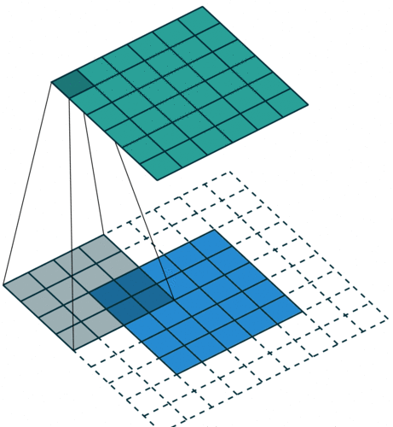
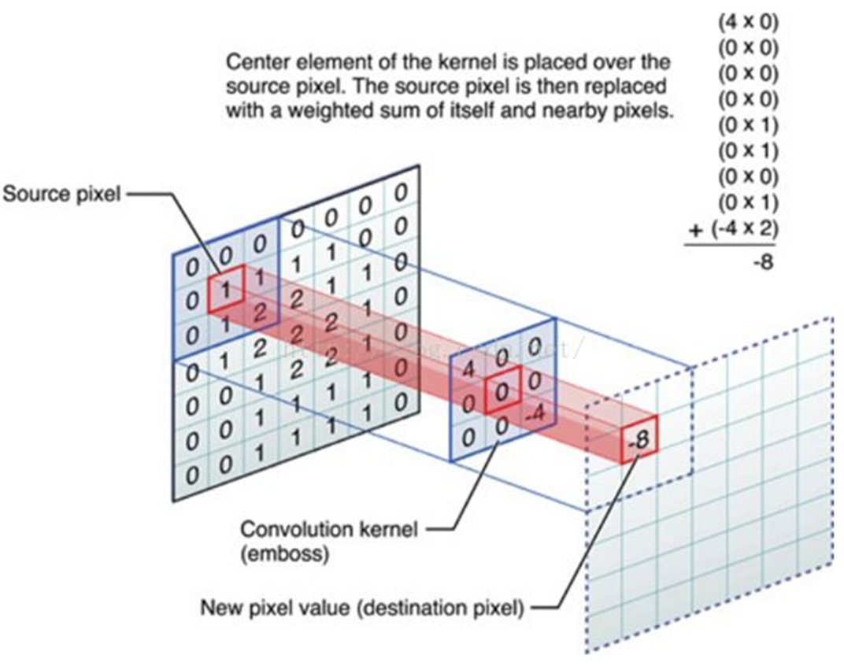
Convolutional kernel - Pathing
Padding on the input volume with zeros in such way that the conv layer does not alter the spatial dimensions of the input

Slide 12
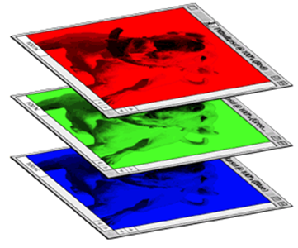
Color image: RGB 3 channels
1 | -1 | -1
-1 | 1 | -1
-1 | -1 | 1
-1 | 1 | -1
-1 | 1 | -1
-1 | 1 | -1
1 | -1 | -1
-1 | 1 | -1
-1 | -1 | 1
-1 | 1 | -1
-1 | 1 | -1
-1 | 1 | -1
1 | -1 | -1
-1 | 1 | -1
-1 | -1 | 1
-1 | 1 | -1
-1 | 1 | -1
-1 | 1 | -1
Filter 1
Filter 2
Color image
1 | 0 | 0 | 0 | 0 | 1
0 | 1 | 0 | 0 | 1 | 0
0 | 0 | 1 | 1 | 0 | 0
1 | 0 | 0 | 0 | 1 | 0
0 | 1 | 0 | 0 | 1 | 0
0 | 0 | 1 | 0 | 1 | 0
1 | 0 | 0 | 0 | 0 | 1
0 | 1 | 0 | 0 | 1 | 0
0 | 0 | 1 | 1 | 0 | 0
1 | 0 | 0 | 0 | 1 | 0
0 | 1 | 0 | 0 | 1 | 0
0 | 0 | 1 | 0 | 1 | 0
1 | 0 | 0 | 0 | 0 | 1
0 | 1 | 0 | 0 | 1 | 0
0 | 0 | 1 | 1 | 0 | 0
1 | 0 | 0 | 0 | 1 | 0
0 | 1 | 0 | 0 | 1 | 0
0 | 0 | 1 | 0 | 1 | 0

Slide 13
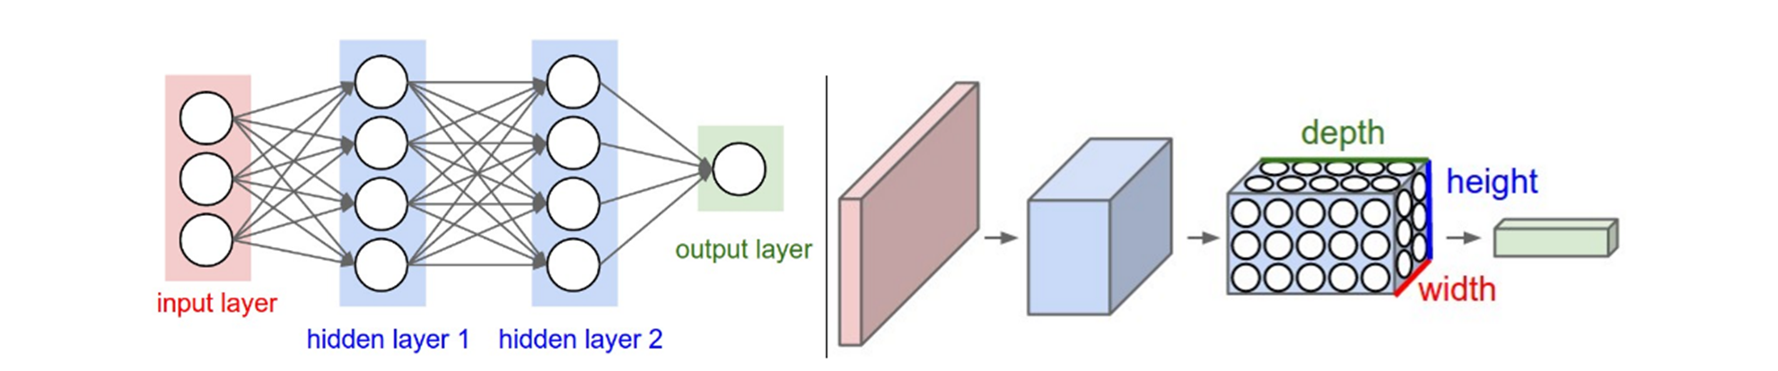
Dense neural network and Convolutional neural network
Left: A regular 3-layer Neural Network. Right: A ConvNet arranges its neurons in three dimensions (width, height, depth), as visualized in one of the layers. Every layer of a ConvNet transforms the 3D input volume to a 3D output volume of neuron activations. In this example, the red input layer holds the image, so its width and height would be the dimensions of the image, and the depth would be 3 (Red, Green, Blue channels).

Slide 14
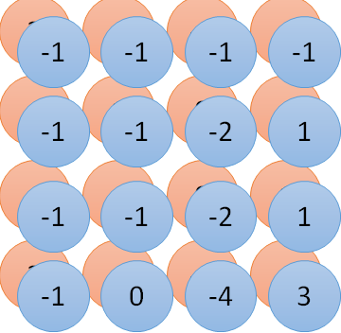
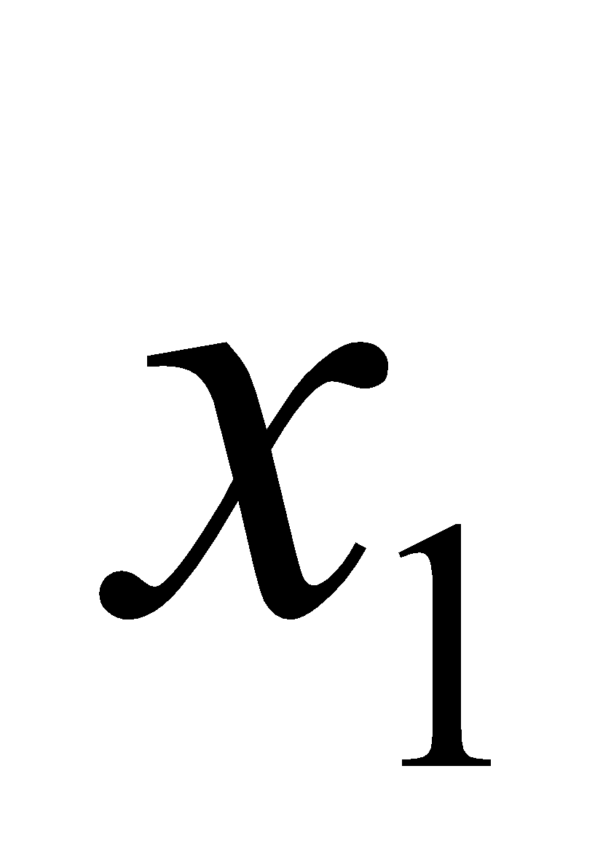
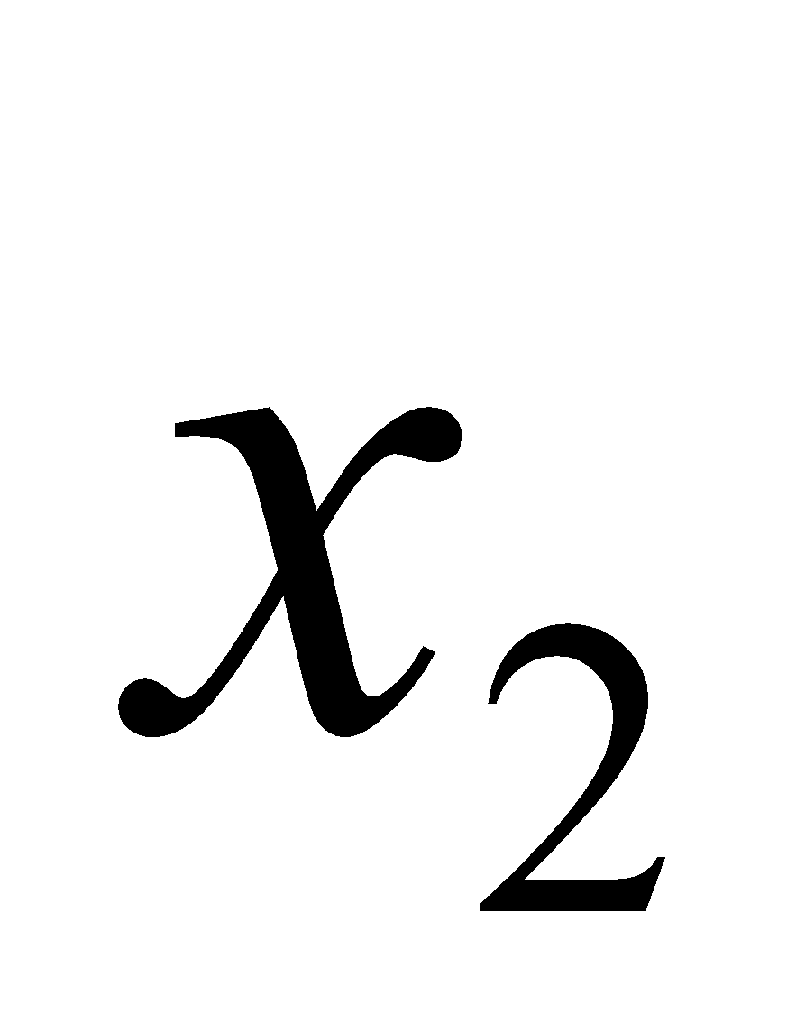
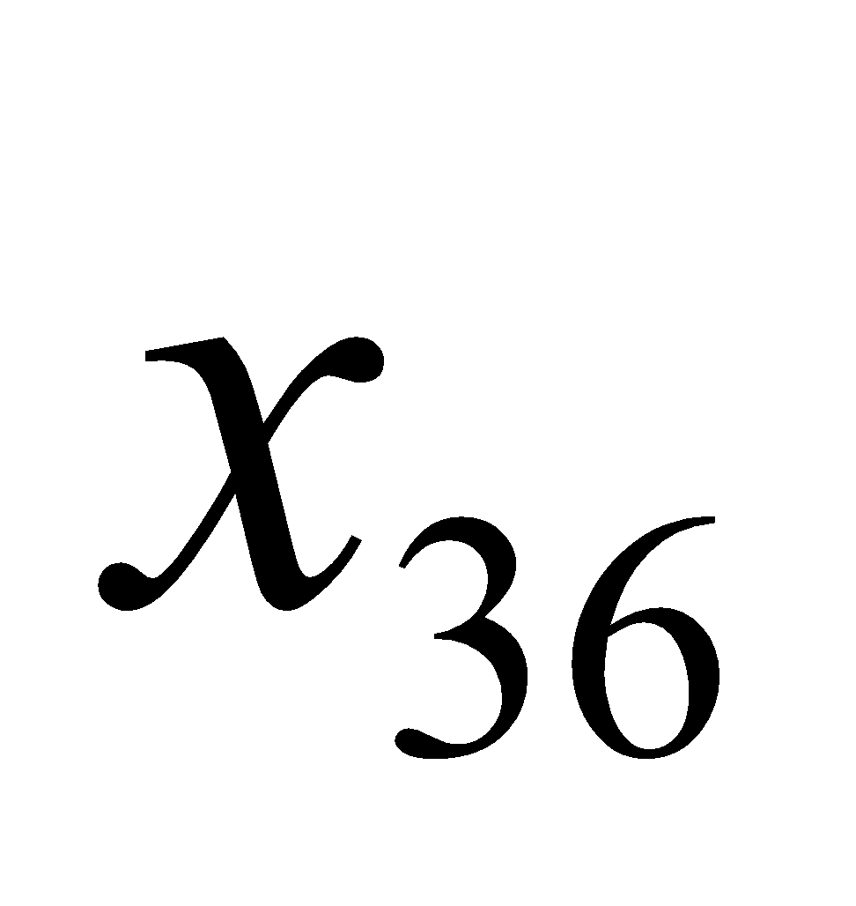
Convolution vs Fully Connected
-1 | 1 | -1
-1 | 1 | -1
-1 | 1 | -1
1 | 0 | 0 | 0 | 0 | 1
0 | 1 | 0 | 0 | 1 | 0
0 | 0 | 1 | 1 | 0 | 0
1 | 0 | 0 | 0 | 1 | 0
0 | 1 | 0 | 0 | 1 | 0
0 | 0 | 1 | 0 | 1 | 0
1 | -1 | -1
-1 | 1 | -1
-1 | -1 | 1
convolution
image
1 | 0 | 0 | 0 | 0 | 1
0 | 1 | 0 | 0 | 1 | 0
0 | 0 | 1 | 1 | 0 | 0
1 | 0 | 0 | 0 | 1 | 0
0 | 1 | 0 | 0 | 1 | 0
0 | 0 | 1 | 0 | 1 | 0
Fully-connected
……
……

Slide 15
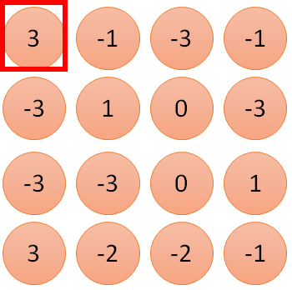
Convolution
1
1
2
0
3
0
4:
3
1 | -1 | -1
-1 | 1 | -1
-1 | -1 | 1
0
Filter 1
…
0
8
1
1 | 0 | 0 | 0 | 0 | 1
0 | 1 | 0 | 0 | 1 | 0
0 | 0 | 1 | 1 | 0 | 0
1 | 0 | 0 | 0 | 1 | 0
0 | 1 | 0 | 0 | 1 | 0
0 | 0 | 1 | 0 | 1 | 0
9
0
10:
0
…
13
0
14
0
Only connect to 9 inputs, not fully connected
15
1
6 x 6 image
16
1
fewer parameters!
…

Slide 16
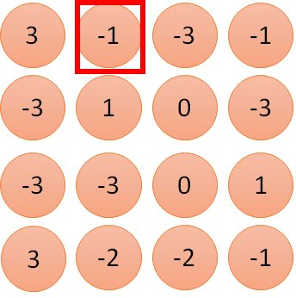
Convolution
1:
1
2:
0
3:
0
3
1 | -1 | -1
-1 | 1 | -1
-1 | -1 | 1
4:
0
Filter 1
…
7:
0
8:
1
1 | 0 | 0 | 0 | 0 | 1
0 | 1 | 0 | 0 | 1 | 0
0 | 0 | 1 | 1 | 0 | 0
1 | 0 | 0 | 0 | 1 | 0
0 | 1 | 0 | 0 | 1 | 0
0 | 0 | 1 | 0 | 1 | 0
-1
9:
0
10:
0
…
13:
0
14:
0
15:
1
6 x 6 image
16:
1
Shared weights
Fewer parameters, Even fewer parameters
…

Slide 17
Feature Map
-1 | 1 | -1
-1 | 1 | -1
-1 | 1 | -1
Filter 2
stride=1
Repeat this for each filter
1 | 0 | 0 | 0 | 0 | 1
0 | 1 | 0 | 0 | 1 | 0
0 | 0 | 1 | 1 | 0 | 0
1 | 0 | 0 | 0 | 1 | 0
0 | 1 | 0 | 0 | 1 | 0
0 | 0 | 1 | 0 | 1 | 0
3
-1
-3
-1
-1
-1
-1
-1
-3
1
0
-3
-1
-1
-2
1
Feature
Map
-3
-3
0
1
-1
-1
-2
1
3
-2
-2
-1
-1
0
-4
3
6 x 6 image
Result: Two 4 x 4 images
Forming 2 x 4 x 4 matrix

Slide 18
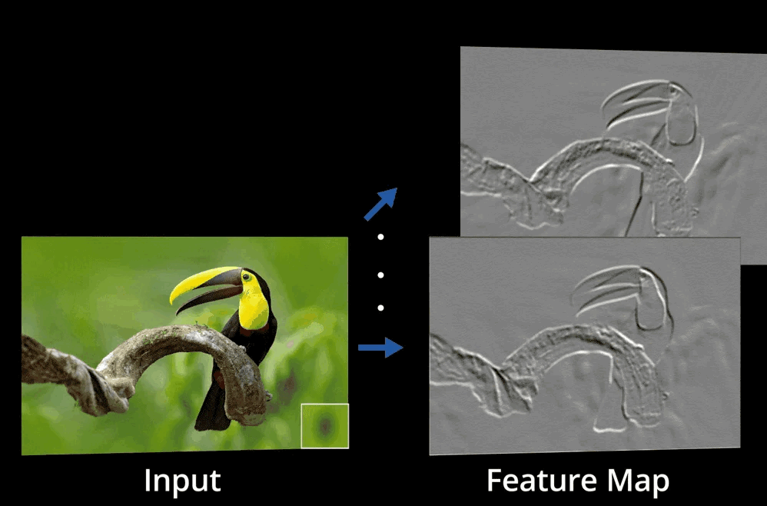
Feature Map

Slide 19
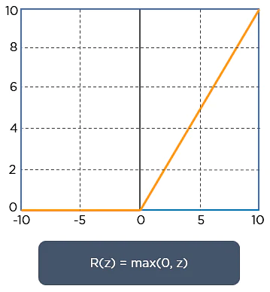
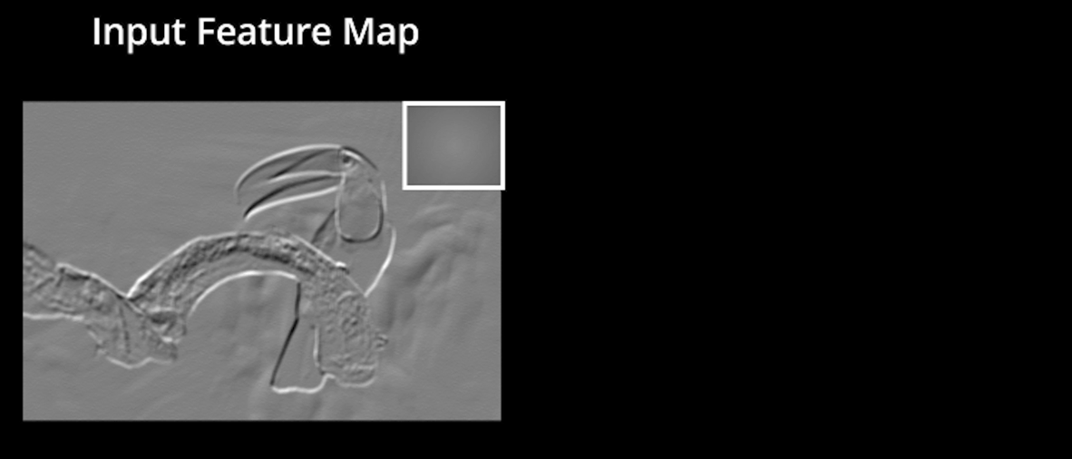
ReLU
Once the feature maps are extracted, the next step is to move them to a ReLU layer.
ReLU performs an element-wise operation and sets all the negative pixels to 0.
It introduces non-linearity to the network
The generated output is a rectified feature map.

Slide 20
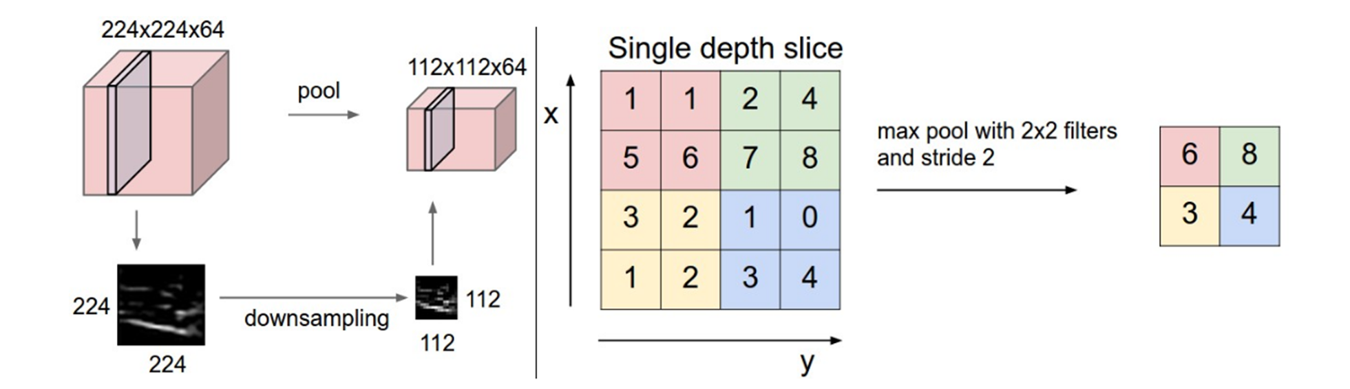
Pooling layer
Pooling layer downsamples the volume spatially, independently in each depth slice of the input volume. Left: In this example, the input volume of size [224x224x64] is pooled with filter size 2, stride 2 into output volume of size [112x112x64]. Notice that the volume depth is preserved. Right The most common downsampling operation is max, giving rise to max pooling, here shown with a stride of 2. That is, each max is taken over 4 numbers (little 2x2 square).

Slide 21


Why Pooling
Subsampling pixels will not change the object
bird
bird
Subsampling
Subsample the pixels to make image smaller
fewer parameters to characterize the image

Slide 22
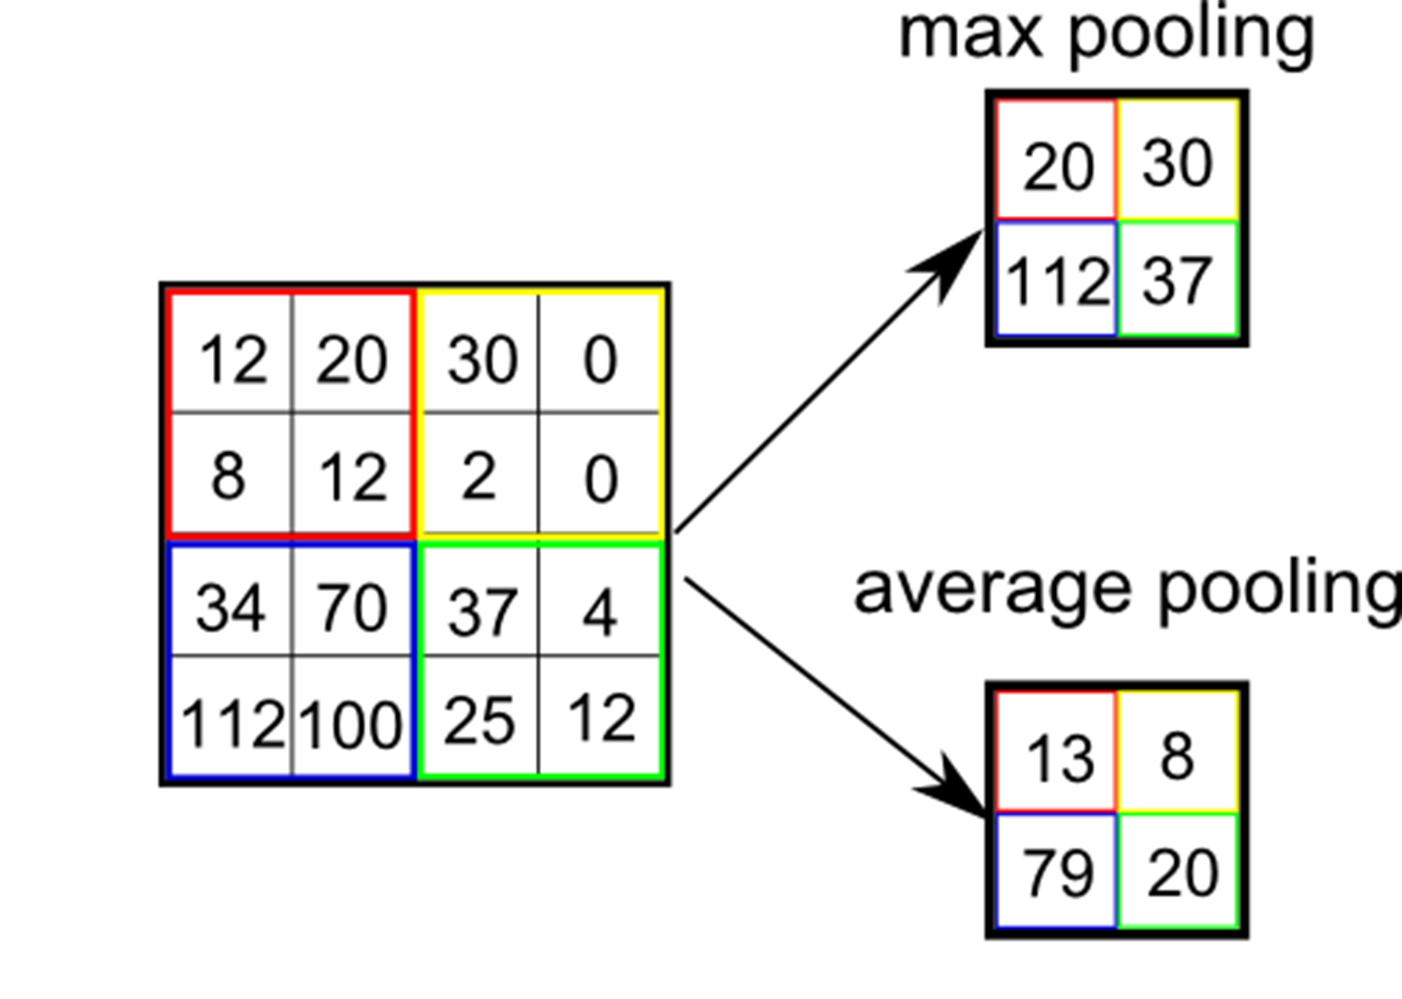
Different types of pooling
Max Pooling
Min Pooling
Average Pooling
Global Pooling
aggressively summarize the presence of a feature in an image.

Slide 23
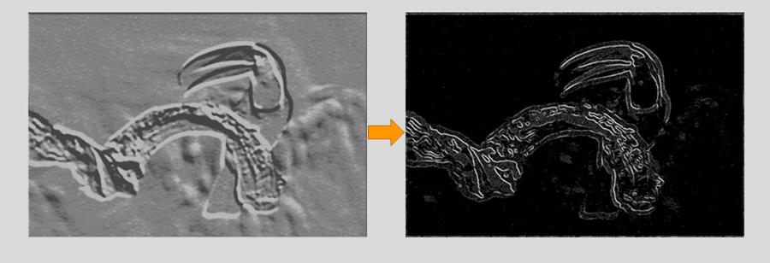
Why pooling
The pooling layer uses various filters to identify different parts of the image like edges, corners, body, feathers, eyes, and beak.

Slide 24


The whole CNN
Can repeat many times
Convolution
Pooling
Convolution
Pooling
cat dog ……
Flattened
Fully Connected Feedforward network

Slide 25
The whole CNN
Convolution
Pooling
Convolution
Pooling
A new image
3
0
-1
1
Smaller than the original image
3
1
0
3
The number of channels is the number of filters

Slide 26
Flattening
Flattening is used to convert all the resultant 2-Dimensional arrays from pooled feature maps into a single long continuous linear vector.
3
0
1
3
0
3
-1
1
-1
1
0
3
3
Flattened
1
0
Fully Connected Feedforward network
3

Slide 27
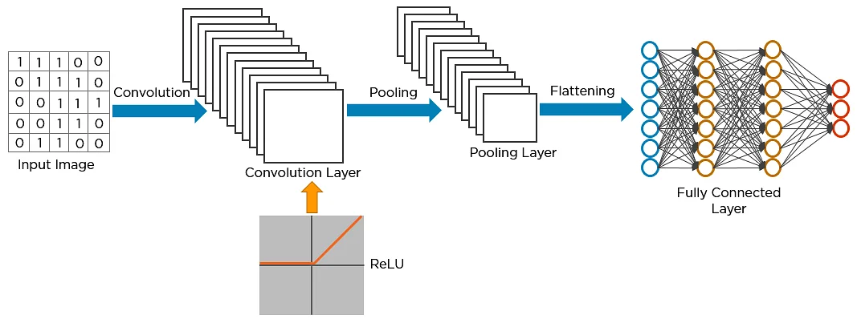
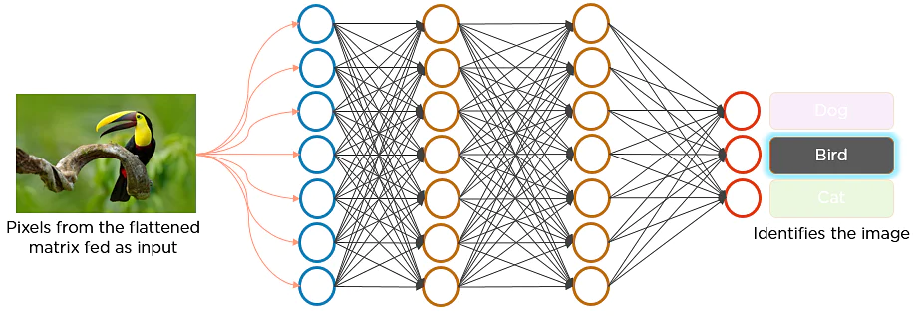
Flattening
The flattened matrix is fed as input to the fully connected layer to classify the image.

Slide 28
The whole CNN
A new image
Convolution
Pooling
Convolution
Pooling
A new image
cat dog ……
Flattened
Fully Connected Feedforward network

Slide 29
How the CNN Recognizes Images
The pixels from the image are fed to the convolutional layer that performs the convolution operation It results in a convolved map
The convolved map is applied to a ReLU function to generate a rectified feature map
The image is processed with multiple convolutions and ReLU layers for locating the features
Different pooling layers with various filters are used to identify specific parts of the image
The pooled feature map is flattened and fed to a fully connected layer to get the final output

Slide 30
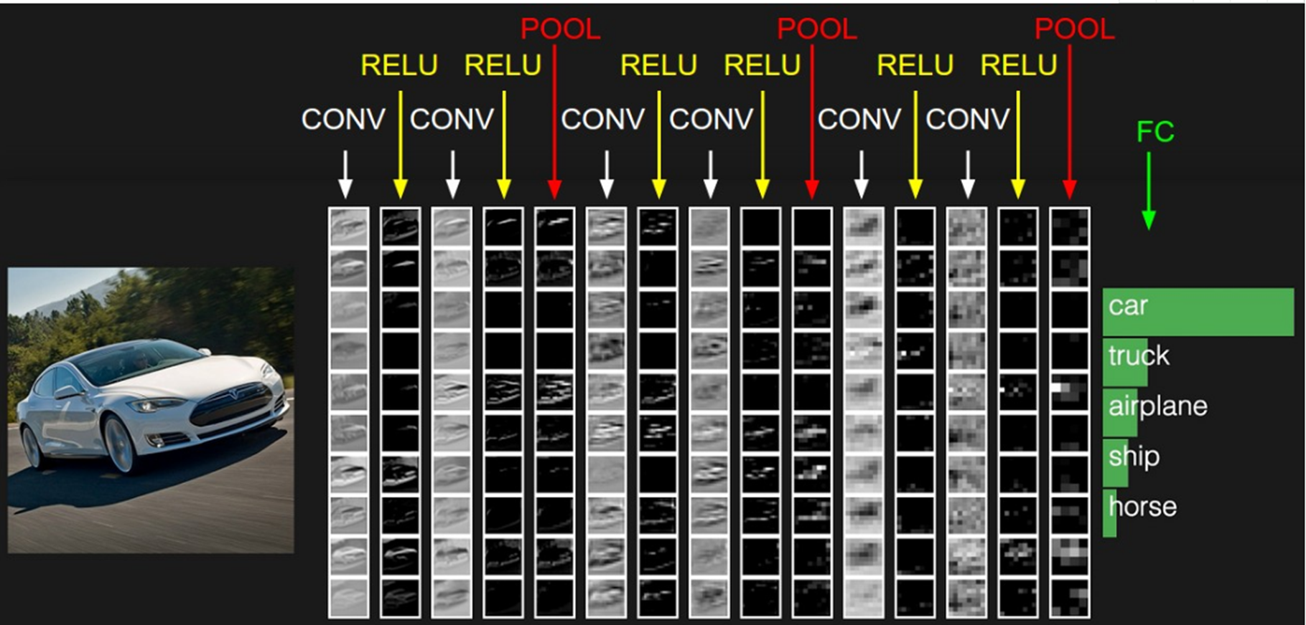
A simple CNN structure
CONV: Convolutional kernel layer, RELU: Activation function, POOL: Dimension reduction layer, FC: Fully connected layer

Slide 31
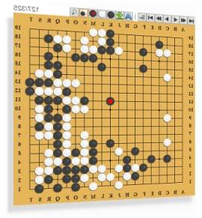
AlphaGo
It is a 19 x 19 matrix
Black: 1
white: -1
none: 0
Fully-connected feedforward network can be used
But CNN performs much better
Neural
Network
Next move
(19 x 19 positions)

Slide 32
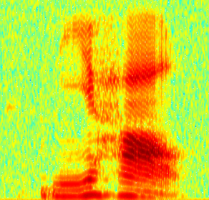
CNN in speech recognition
The filters move in the frequency direction.
CNN
Frequency
Image
Time
Spectrogram

Slide 33
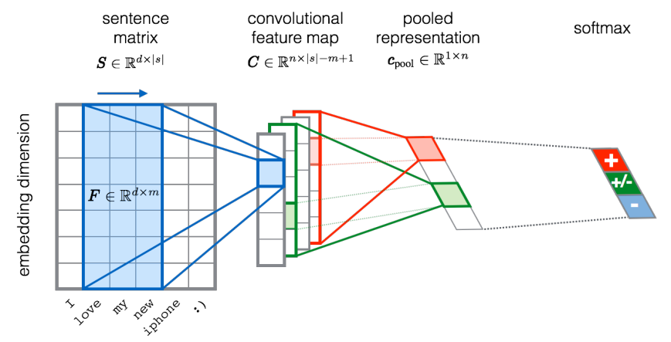
CNN in text classification
?

Slide 34
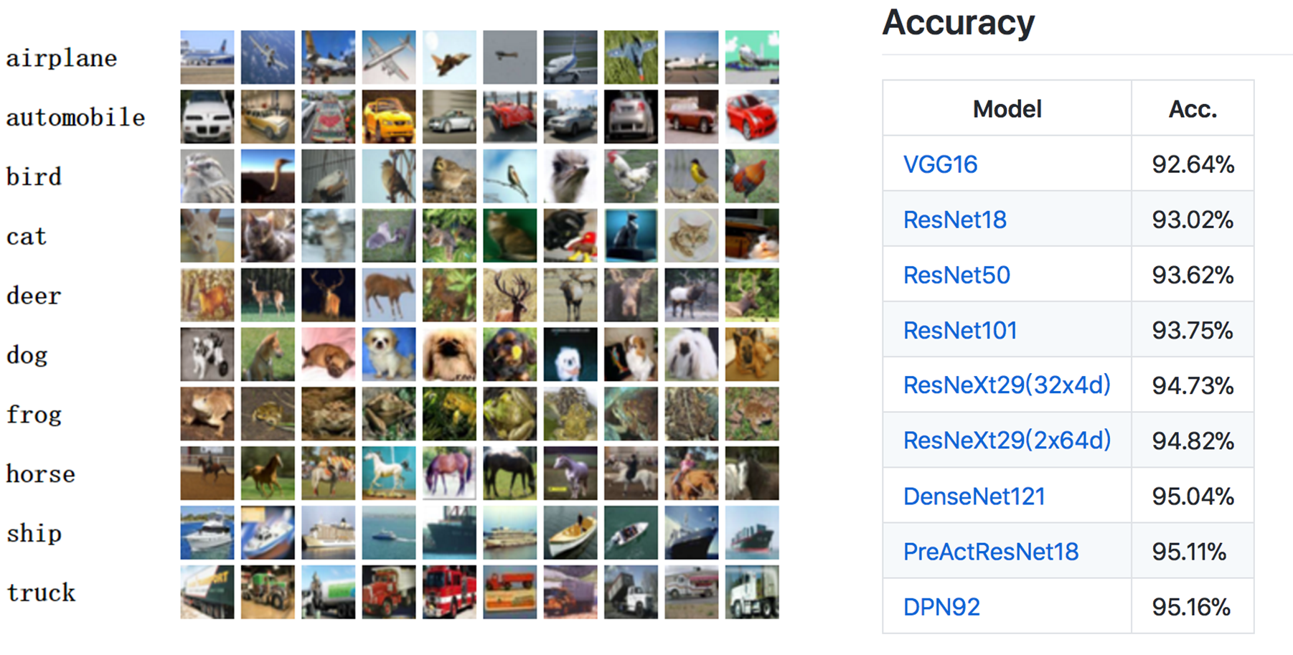
CIFAR10 dataset and state of the art
The CIFAR-10 dataset consists of 60000 32x32 color images in 10 classes,
with 6000 images per class. There are 50000 training images and 10000 test images.

Slide 35
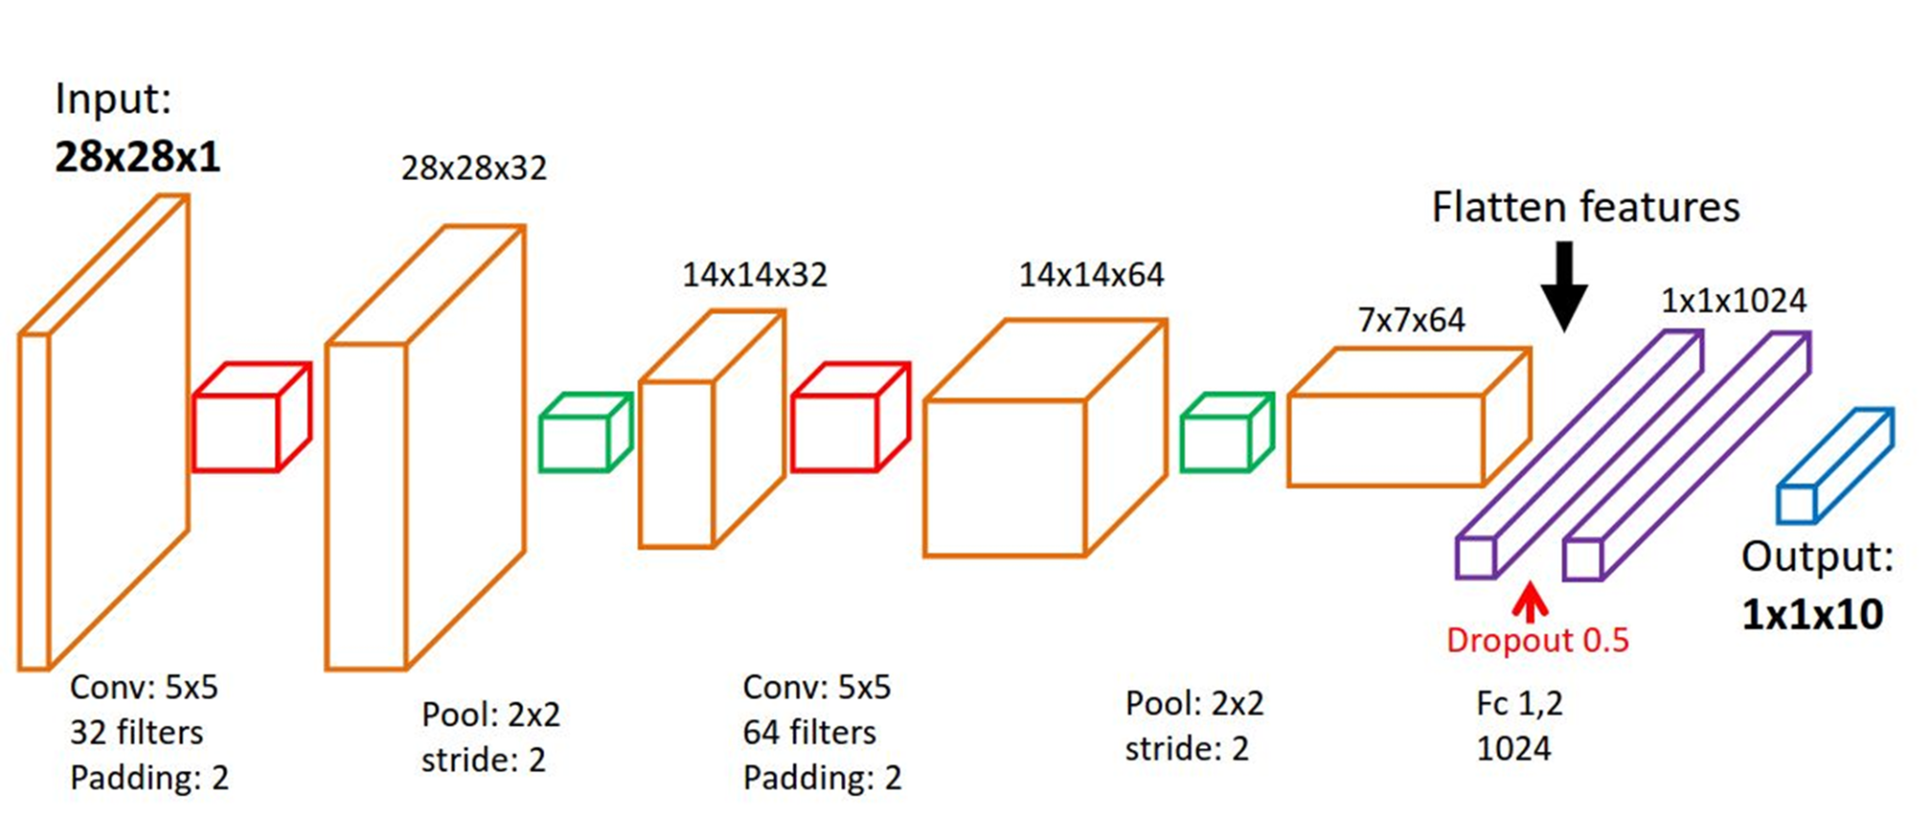
LeNet-5 for MNIST

Slide 36
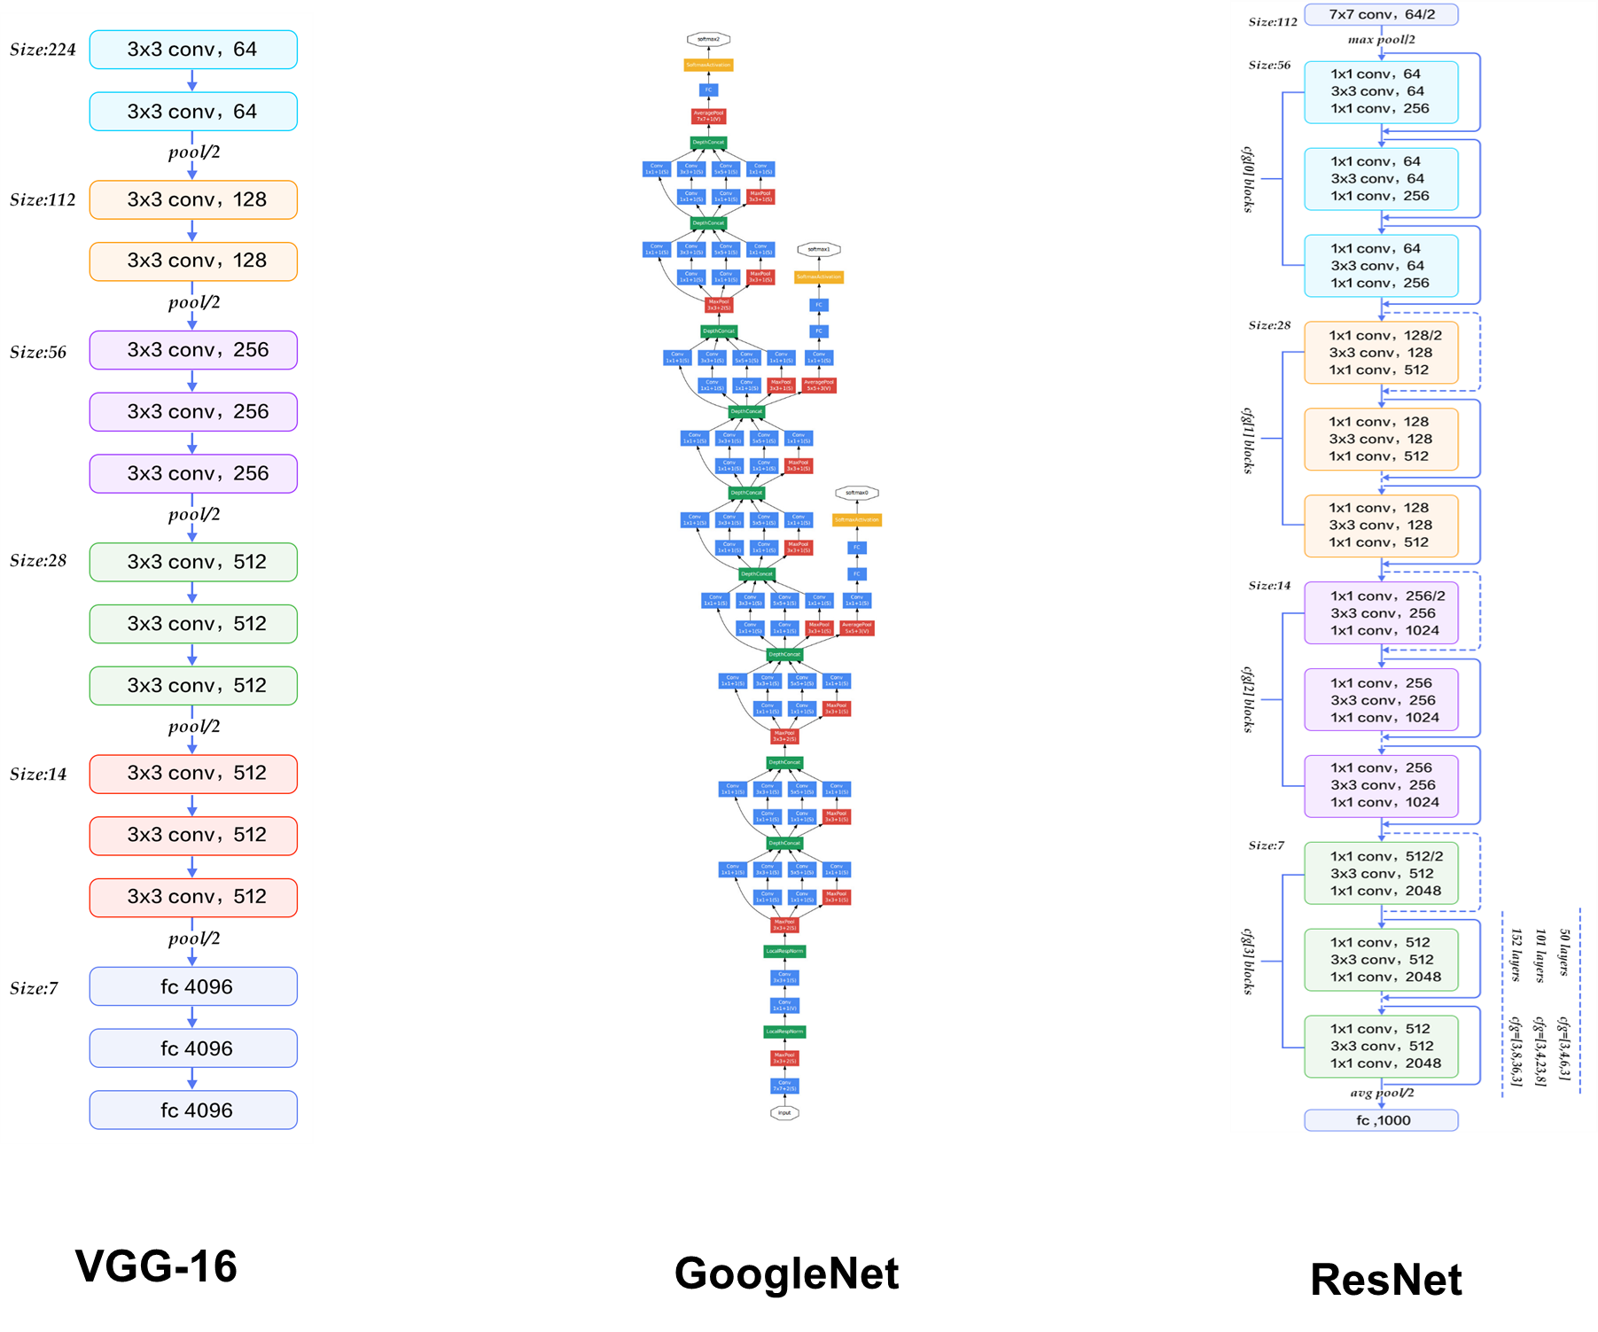

Slide 37
Case Studies
LeNet. The first successful applications of Convolutional Networks were developed by Yann LeCun in 1990’s. Of these, the best known is the LeNet architecture that was used to read zip codes, digits, etc.
AlexNet. The first work that popularized Convolutional Networks in Computer Vision was the AlexNet, developed by Alex Krizhevsky, Ilya Sutskever and Geoff Hinton. The AlexNet was submitted to the ImageNet ILSVRC challenge in 2012 and significantly outperformed the second runner-up (top 5 error of 16% compared to runner-up with 26% error). The Network had a very similar architecture to LeNet, but was deeper, bigger, and featured Convolutional Layers stacked on top of each other (previously it was common to only have a single CONV layer always immediately followed by a POOL layer).

Slide 38
Case Studies
GoogLeNet. The ILSVRC 2014 winner was a Convolutional Network from Szegedy et al. from Google. Its main contribution was the development of an Inception Module that dramatically reduced the number of parameters in the network (4M, compared to AlexNet with 60M). Additionally, this paper uses Average Pooling instead of Fully Connected layers at the top of the ConvNet, eliminating a large amount of parameters that do not seem to matter much. There are also several follow up versions to the GoogLeNet, most recently Inception-v4.

Slide 39
Case Studies
VGGNet. The runner-up in ILSVRC 2014 was the network from Karen Simonyan and Andrew Zisserman that became known as the VGGNet. Its main contribution was in showing that the depth of the network is a critical component for good performance. Their final best network contains 16 CONV/FC layers and, appealingly, features an extremely homogeneous architecture that only performs 3x3 convolutions and 2x2 pooling from the beginning to the end. Their pretrained model is available for plug and play use in Caffe. A downside of the VGGNet is that it is more expensive to evaluate and uses a lot more memory and parameters (140M). Most of these parameters are in the first fully connected layer, and it was since found that these FC layers can be removed with no performance downgrade, significantly reducing the number of necessary parameters.

Slide 40
Case Studies
ResNet. Residual Network developed by Kaiming He et al. was the winner of ILSVRC 2015. It features special skip connections and a heavy use of batch normalization. The architecture is also missing fully connected layers at the end of the network. The reader is also referred to Kaiming’s presentation (video, slides), and some recent experiments that reproduce these networks in Torch. ResNets are currently by far state of the art Convolutional Neural Network models and are the default choice for using ConvNets in practice (as of May 10, 2016). In particular, also see more recent developments that tweak the original architecture from Kaiming He et al. Identity Mappings in Deep Residual Networks (published March 2016).

